Slide 1

Department of Computer Science and Engineering
SKIN LESION CLASSIFICATION
#TO DO Date: 27 May 2021
K.HARSHINI : 17WH1A0522
V.PRAVALIKA : 17WH1A0543
K.CHAITRA : 17WH1A0509
Internal Guide: Mr.Y.Madan Reddy
Designation: Assistant Professor
BVRIT HYDERABAD College of Engineering for Women

Slide 2

Abstract
Why Should I Study this course?
Problem Statement:
Melanoma is deadly Skin Cancer. There is a high similarity between different kinds of skin lesion, which leads to incorrect classification. Accurate classification of a skin lesion in its early stages saves human life.
Project Objective:
This project aims at classifying skin lesion images in to 7 classes namely
>Melanoma
>Melanocytic nevus
>Basal cell carcinoma
>actinic keratosis
>Benign keratosis
>Dermatofibroma
>Vascular lesion using neural networks.
Examples
BVRIT HYDERABAD College of Engineering for Women

Slide 3
Dataset
Dataset Description:
It has 3 files, 2 files containing 5000 images and 1 csv file containing metadata HAM10000 is a dataset of 10015 training images for detecting pigmented skin lesions. This dataset has been formed by collecting dermatoscopic images from different populations, acquired and stored by different modalities.
Attribute | Description
lesion_id | Unique number representing a lesion type
image_id | Unique number identifying the image
dx | Abbreviation for the lesion type (nv -> Melanocytic nevus, bkl -> Benign keratosis)
dx_type | Shows which test concluded the lesion (dermastopic analysis, biopsy, histopathical examination, others)
age | Person’s age
sex | Male/Female
localization | Indicates the position of lesion in human body (ear, back, hand, etc)

Slide 4
Architecture
Data acquisition
Data-processing and cleaning
EDA
CNN-model building
(MobileNet)
Fitting model
Model evaluation
BVRIT HYDERABAD College of Engineering for Women

Slide 5
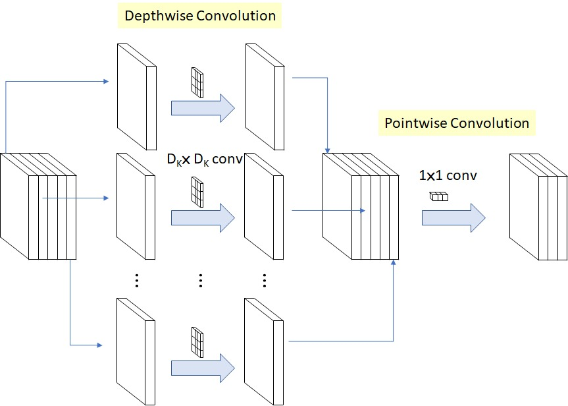
Depthwise v/s Pointwise Convolution
Depthwise Convolution: Apply single convolution filter for each input element
Pointwise Convolution: Iterates 1x1 kernel through every single point

Slide 6
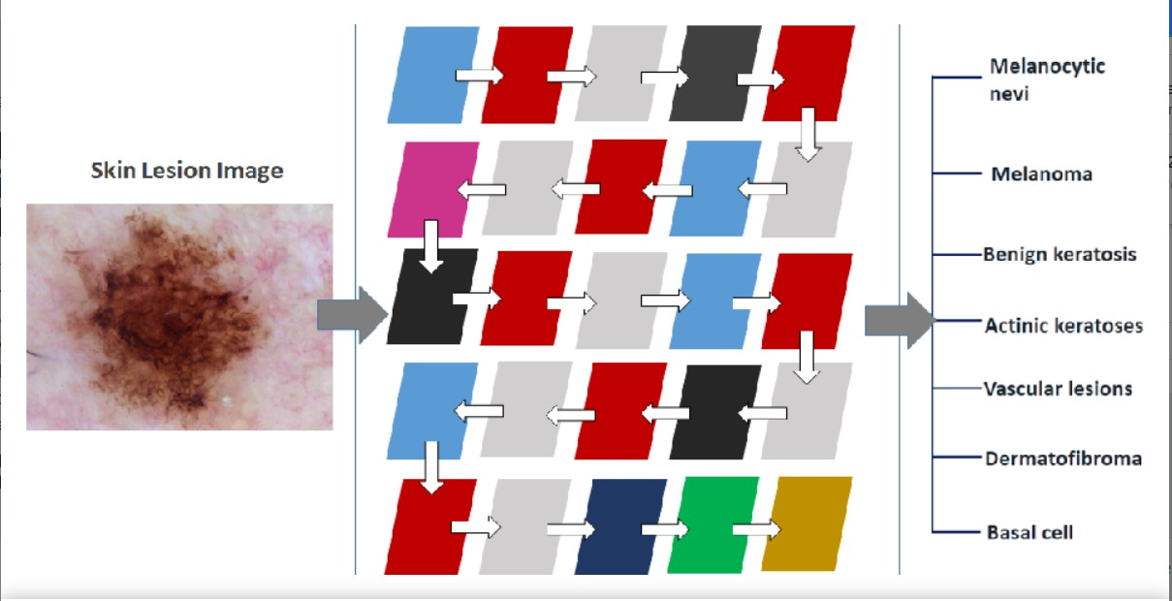
CNN-MobileNet Architecture

Slide 7
Technology Stack
Supervised Machine Learning
Language : Python
IDE : Google Colab
Libraries : pandas, matplotlib, sklearn, keras (tensorflow)

Slide 8
System Requirements
Environment | Speciﬁcations
Hardware | Processor - Intel Core i3 Memory(RAM) - 4 GB Storage - 500GB
Software | Windows 7/Ubuntu

Slide 9
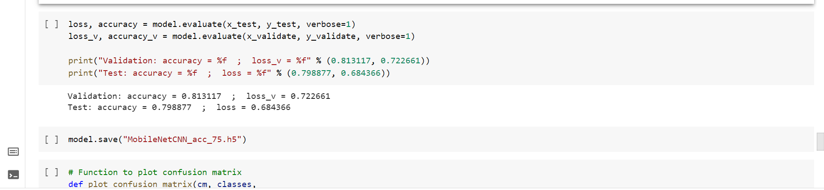
Accuracy

Slide 10
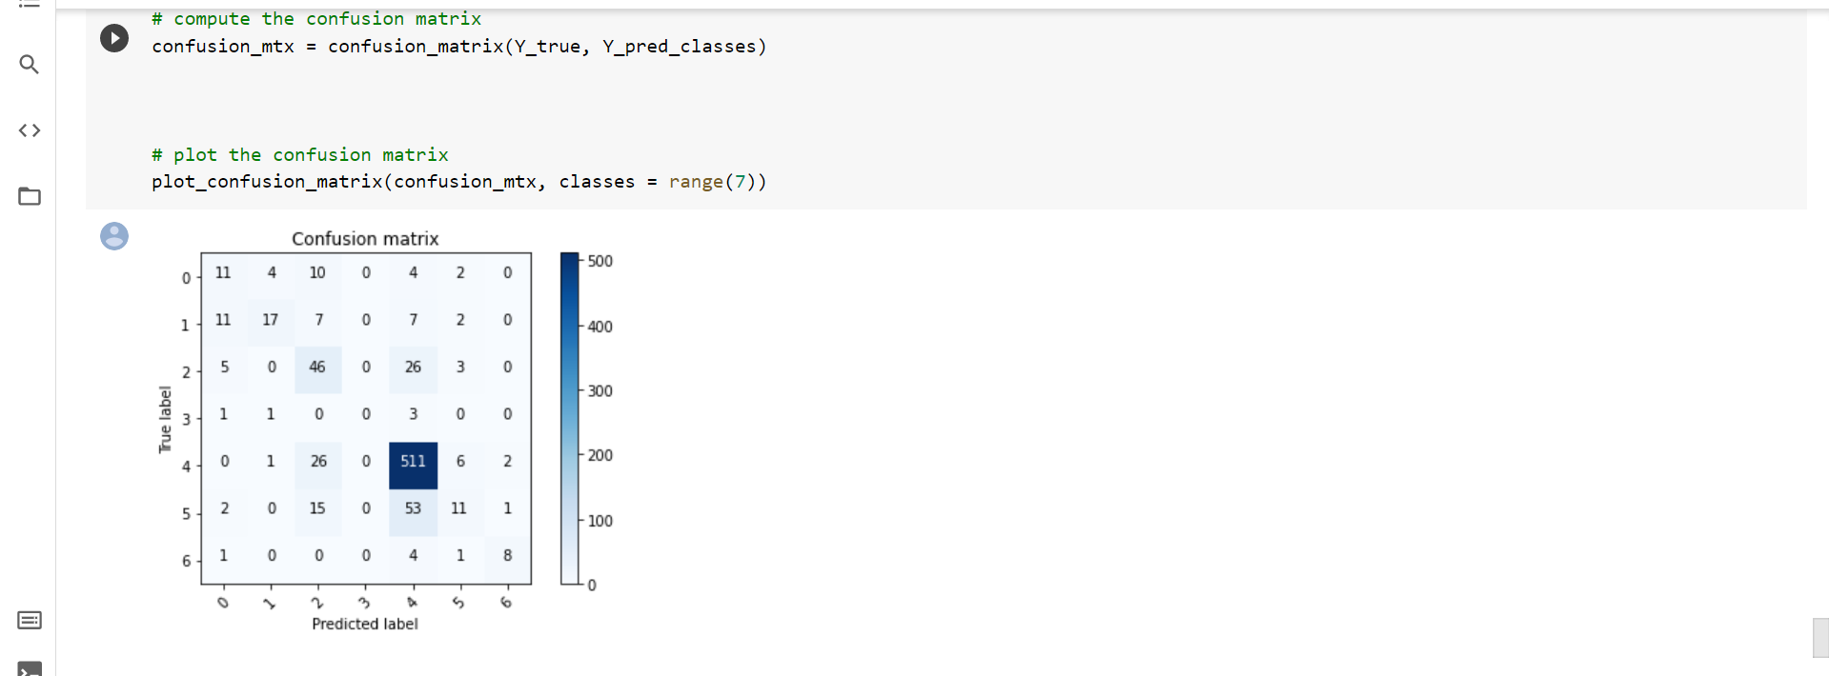
Confusion Matrix

Slide 11
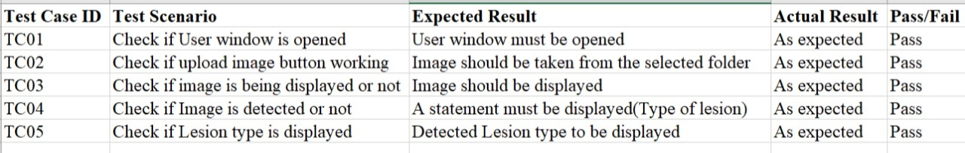
Test Cases

Slide 12
References
[1] Saket S. Chaturvedi, Kajol Gupta, Prakash. S. Prasad, “Skin Lesion Analyser: An Efficient Seven-Way Multi-Class Skin Cancer Classification Using MobileNet”,May. 2020.
https://arxiv.org/abs/1907.03220
[2]Data set
https://www.kaggle.com/kmader/skin-cancer-mnist-ham10000
[3]M. A. A. Milton, “Automated Skin Lesion Classification Using Ensemble of Deep Neural Networks in ISIC 2018: Skin Lesion Analysis Towards Melanoma Detection Challenge,” Jan. 2019.
[4] Kawahara J, Hamarneh G. Multi-resolution-Tract CNN with Hybrid Pretrained and Skin Lesion Trained Layers. In: Wang L, Adeli E, Wang Q, Shi Y, Suk HI (eds) Machine Learning in Medical Imaging. MLMI 2016. Lecture Notes in Computer Science. 2016;10019. https://doi.org/10.1007/978-3-319-47157-0_20

Slide 13
Thank you

